Slide 1
Marketing Analytics
Session 6
Advanced topics in scoring models

Slide 2
Sessions
S1 – Oct 3
S2 – Oct 10
S3 – Oct 17
S4 – Oct 24
S5 – Oct 31
Course introduction
SQL
Segmentation
Data visualization
DUE DATE
Oct 30
Assignment 1
(report)
Database & SQL
R & ODBC
Scoring
S6 – Nov 7
S7 – Nov 21
S8 – Nov 28
S9 – Dec 5
S10 – Dec 12
Scoring
advanced topics
DUE DATE
Nov 20
DUE DATE
FRIDAY Dec 9
Assignment 2
(scoring)
Lifetime value
Market basket analysis
Assignment 3 (project)
Social network analysis
Q&A

Slide 3
Agenda
Gain chart & model lift
Cross-validation
Cross-validation, multifold cross-validation, and jackknifing
Model likelihood
Model likelihood (ML), log-likelihood (LogL), and maximum likelihood estimation (MLE)
Multicollinearity
Penalized regression
Lasso, ridge, and elasticNet

Slide 4
Agenda
Gain chart & model lift (does it work?)
Cross-validation (does it work too well?)
Cross-validation, multifold cross-validation, and jackknifing
Model likelihood
Model likelihood (ML), log-likelihood (LogL), and maximum likelihood estimation (MLE)
Multicollinearity
Penalized regression (how can it work better?)
Lasso, ridge, and elasticNet

Slide 5
Gain chart
Assessing model performance

Slide 6
Gain chart
A gain chart illustrates the ability of a predictive model to recover the target behavior

Slide 7
Lift
The lift of a model is a measure of how much better the model performs compared to chance

Slide 8
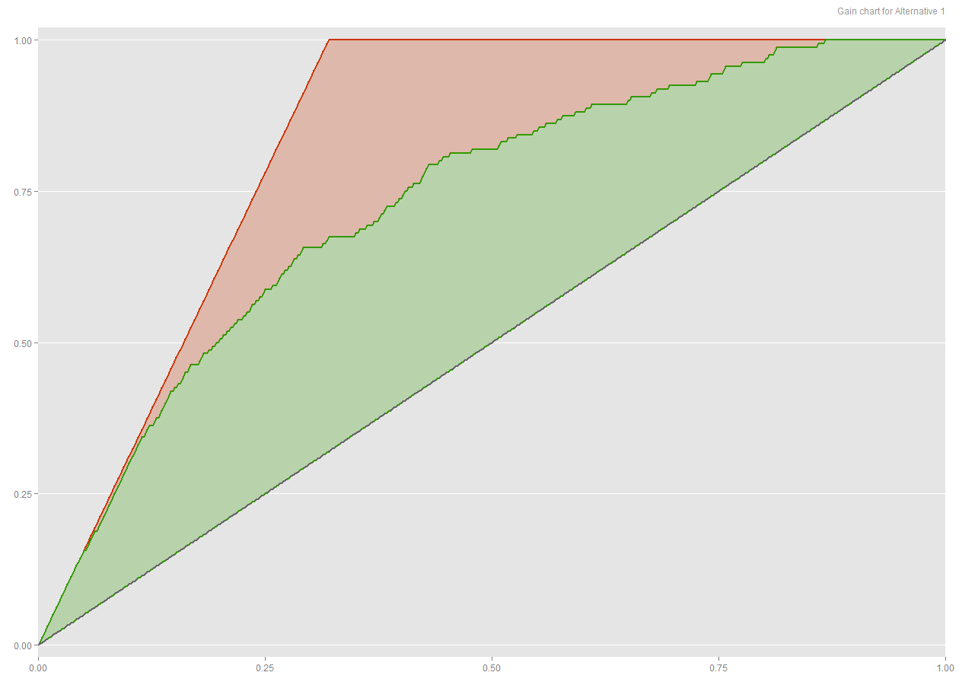
Gain chart
Perfect
Model
Random

Slide 9
How to construct a gain chart
Random:
x = all the individuals in random order
y = cumulative % of hit (random selection)
Perfect:
x = individuals by decreasing order of target variable
y = cumulative % of actual hit (perfect selection)
Model:
x = individuals by decreasing order of predicted target variable
y = cumulative % of actual hit (model performance)

Slide 10
Lift at 25%
A
LIFT = A / B
B

Slide 11
Performance at 25%
B
A
PERFORMANCE = A / B
(sometimes called improvement)

Slide 12
Construct a gain chart in R
# One of the libraries available for the logit model
library(nnet)
# Logit model
model = multinom(formula = loyal ~ (recency * frequency) + log(recency) + log(frequency), data = data)
# Obtain predictions (on the same data set)
probs = predict(object = model,
newdata = data,
type = "probs")

Slide 13
Construct a gain chart in R
# Rank order target variable in decreasing order
# of (predicted) probability
target = data$loyal[order(probs, decreasing=TRUE)]
/ sum(data$loyal)
gainchart = c(0, cumsum(target))
# Create a random selection sequence
random = seq(0, to = 1, length.out = length(data$loyal))
# Create the "perfect" selection sequence
perfect = data$loyal[order(data$loyal, decreasing=TRUE)]
/ sum(data$loyal)
perfect = c(0, cumsum(perfect))
# Plot gain chart, add random line
plot(gainchart)
lines(random)
lines(perfect)

Slide 14
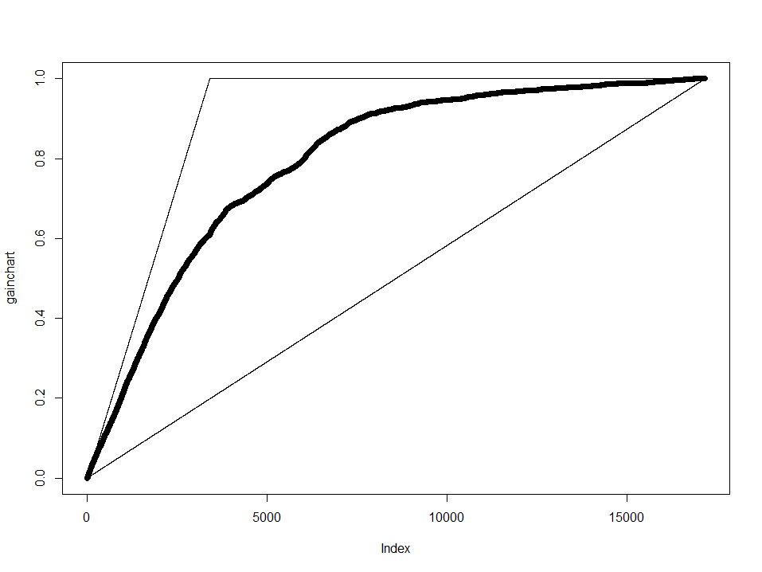
Gain chart

Slide 15
Compute lift and improvement
# Compute 1%, 5%, 10%, and 25% lift and improvement
q = c(0.01, 0.05, 0.10, 0.25)
x = quantile(gainchart, probs = q)
z = quantile(perfect, probs = q)
print("Hit rate:")
print(x)
print("Lift:")
print(x/q)
print("Improvement:")
print((x-q)/(z-q))

Slide 16
Cross-validation
Anticipating out-of-sample performance

Slide 17
Problem statement
Suppose you fit a linear model on 4 observations
Obviously the “in-sample” fit is pretty good

Slide 18
Problem statement
Now, use the same model to run out-of-sample predictions
The “out-of-sample” performance might not be as good

Slide 19
Overfit
A model is said to overfit the data when it captures noise such that in-sample fit is improved, but out-of-sample fit is degraded

Slide 20
Related to bias-variance trade-off
Models with high variance fit the training data well, but may not generalize (“overfit”)
Models with high bias (usually simpler models) generalize well, but may not fit the training data well

Slide 21
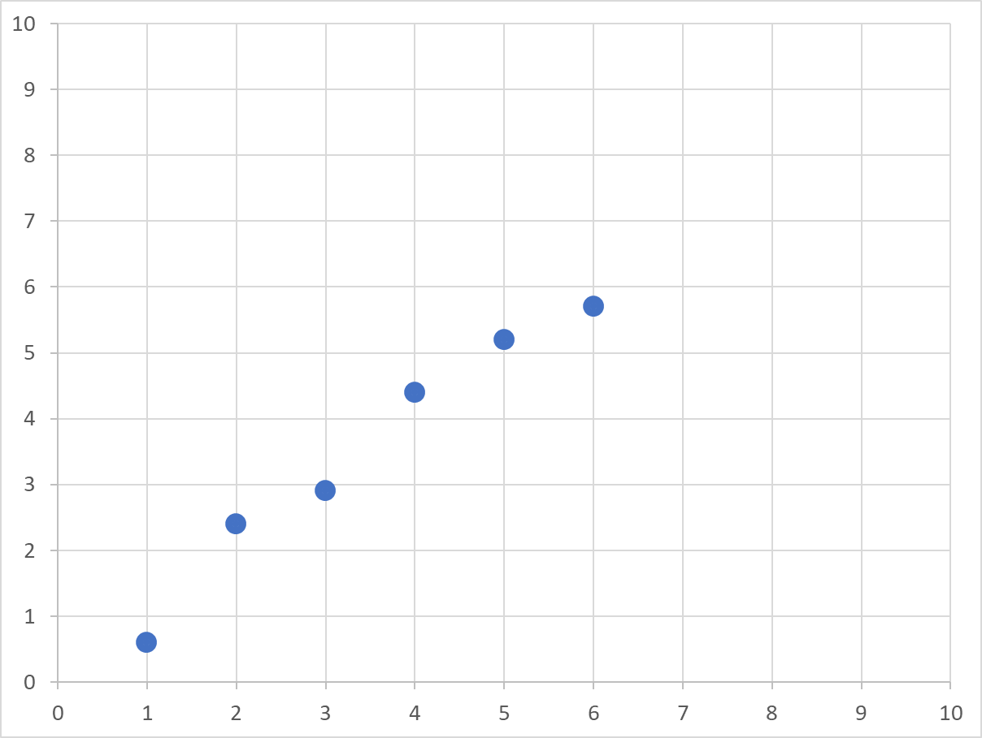
Data

Slide 22
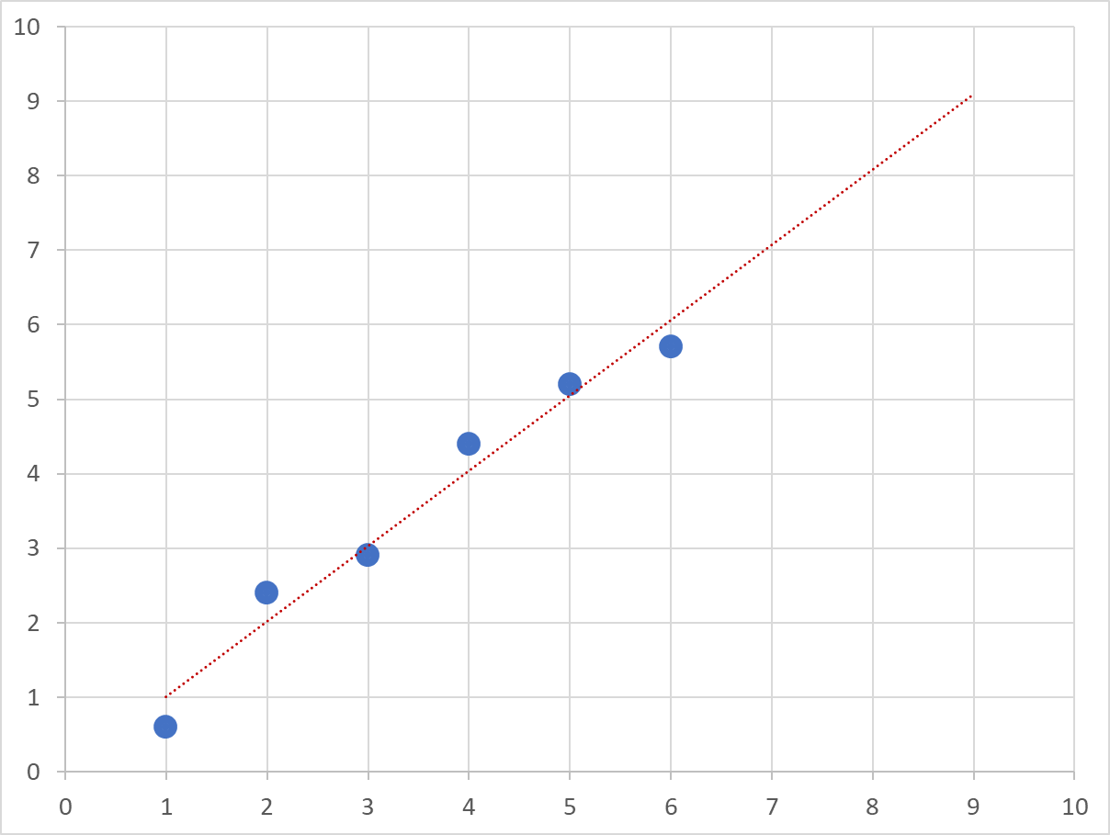
Low variance / high bias

Slide 23
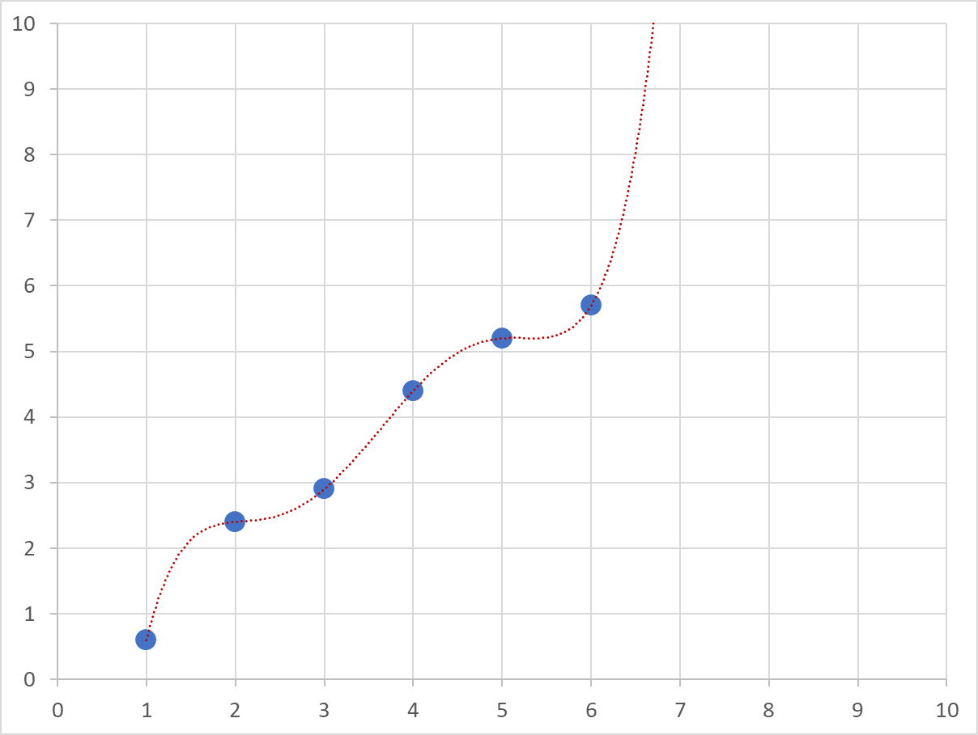
Low bias / High variance

Slide 24
Overfitting
Overfitting is a huge issue in predictive modeling, since it will give the analyst unwarranted confidence in the model predictions
Most likely to happen when:
Small data set
Many predictors
Correlated predictors
Notes:
Example: a geographic map is a model. A model is designed for a specific purpose.
e.g. a map to navigate does not include all details of the environment (houses etc), but only roads, highway numbers and distances

Slide 25
Cross-validation
Cross-validation is the process of leaving out some observations during model calibration, and using those leftover observations for model validation
It creates an artificial out-of-sample (validation) data set

Slide 26
Cross-validation
Classic approach
Cross-validation approach
MODEL CALIBRATION
MODEL VALIDATION
MODEL VALIDATION
MODEL CALIBRATION

Slide 27
Machine learning
In machine learning, these are often called training data set and testing data set

Slide 28
Cross-validation, pro and con
Pro:
Separate model calibration from model validation
Diagnostic will be more trustworthy
Con:
Validate model on (say) 20% of the observations only
If we increase the validation sample, model calibration will suffer
If we increase the calibration sample, model validation will be more random, less trustworthy
Solution → Multifold cross-validation

Slide 29
5-fold cross-validation

Slide 30
Multi-fold cross-validation
The more « folds » you have, the larger your calibration samples
But many folds will take a lot of time, because each requires its own model
Validation sample has always the size of your data set

Slide 31
Illustration

Slide 32
Jackknifing
Jackknifing is a special case of multifold cross-validation, where there are N folds, and N is the size of the sample
(Validation is made on one observation at a time. OK for very small samples, but avoid otherwise)

Slide 33
5-fold cross validation
...
# One of the libraries available for the logit model
library(nnet)
# Compute the logit model on the entire data set
# These are the predictions you need to use later on
formula = "loyal ~ (recency * frequency)
+ log(recency) + log(frequency)"
model = multinom(formula, data)

Slide 34
5-fold cross validation
# Run a nfold cross-validation
nfold = 5
nobs = nrow(data)
index = rep(1:nfold, length.out = nobs)
probs = rep(0, nobs)
for (i in 1:nfold) {
# Assign in-sample and out-of-sample observations
insample = which(index != i)
outsample = which(index == i)
# Run model on in-sample data only
submodel = multinom(formula, data[insample, ])
# Obtain predicted probabilities on out-of-sample data
probs[outsample] = predict(object = submodel,
newdata = data[outsample, ],
type = "probs")
}

Slide 35
Model likelihood

Slide 36
Model likelihood
The model likelihood is the probability that a particular model (and model parameters) could have generated exactly a particular data set
(i.e., given the model, how likely is the data ?)

Slide 37

Model likelihood: example
Suppose we flip a coin 5 times
Suppose the coin is "fair"
Equal chances of head or tail
What is the likelihood of obtaining exactly the following results:
Head
Head
Head
Tail
Tail
.50 (50%, or p=.50)
.50
.50
.50
.50

Slide 38
Model likelihood: example
If each draw is independent, then the likelihood of all the observations to happen in that order is:
.50 x .50 x .50 x .50 x .50 = .03125
(3.125%)

Slide 39
Model likelihood: example
What is the model likelihood for different model parameters ?
Model parameter : likelihood of flipping a head

Slide 40
Model likelihood: example
What is the model likelihood for different model parameters ?
Model parameter : likelihood the coin is fair
That model is the most likely
That model is impossible
That model is impossible

Slide 41
Maximum likelihood estimation
Maximum likelihood estimation is a method that finds the combination of parameter estimates that makes the data we observed the most likely to have been generated by the model

Slide 42
Maximum likelihood estimation
Computational methods
Gradient method 1st degree
Conjugate gradient method 1st degree with memory
Newton-Raphson method 2nd degree
Levenberg-Marquardt 1st-2nd degree mix
"Natural" MLE estimators
Linear regression (minimize sum of squared errors)
Average
Etc.

Slide 43
Gradient method
Choose a starting solution
Compute the gradient (first-order derivative)
Move slightly in the direction of higher likelihood (“jump”)
Adjust jump size
Repeat until gradient is flat (=0)

Slide 44
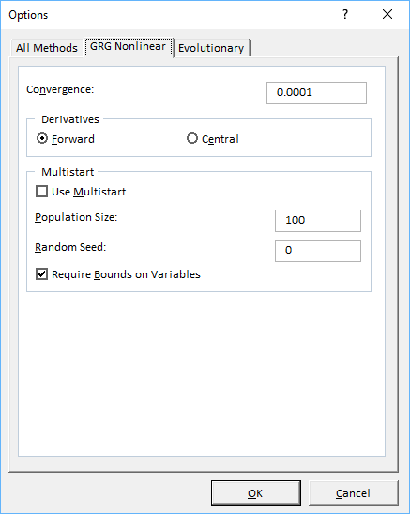
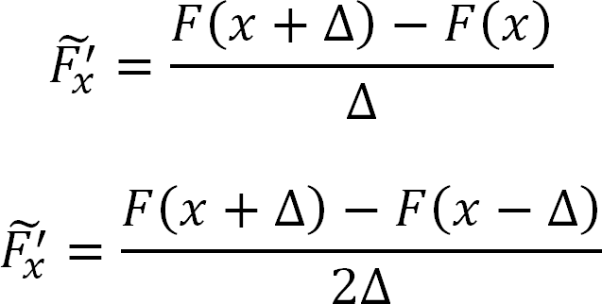
Gradient method
How do you compute the gradient of a function you don't know? You do it computationally…

Slide 45
A few issues
Multiplicative nature of the likelihood
Log-likelihood
Statistical significance
The MLE is reached when p=.6, not p=.5
Does it mean my coin is not fair?
Multicollinearity
Penalized estimation methods

Slide 46
Log-likelihood
If there are many data points, the model likelihood cannot be computed due to machine limitations
We replace the likelihood by its log-transform
likelihood = P₁ x P₂ x P₃ x P₄ x P₅
log-likelihood = log(P₁) + log(P₂) + log(P₃) + log(P₄) + log(P₅)
deviance = -2 log-likelihood
What does it change?
Product becomes a sum
Some probabilities become undefined
The likelihood is positive, bounded [0, 1]
The log-likelihood is negative, unbounded ]–Inf, 0]

Slide 47
Log-likelihood

Slide 48
Log-likelihood
Model likelihood
Model log-likelihood

Slide 49
Statistical significance
MLE
(p=.60)
confidence
confidence interval
Fair
(p=.50)
Model log-likelihood

Slide 50
Statistical tests
Statistical tests:
[parameter value] is different from [reference value]
How likely is this achieved only by chance ?
Usually, the reference value is 0
Is [parameter value] statistically different from 0?
If not, then the predictor might not be predicting anything…
What affects the spread of the "confidence interval"?
Probability threshold (e.g., 0.01, 0.05, 0.10)
Sample size
Whether the likelihood is "spiky" or "flat" (2nd derivative)

Slide 51
Get standard deviations from Hessian
# If you are maximizing a likelihood then the
# covariance matrix of the estimates is
# (asymptotically) the inverse of the negative
# of the Hessian
cov = ginv(-hessian)
# The standard errors are the square roots of the
# diagonal elements of the covariance
stdev = sqrt(diag(cov))
# Compute 5% confidence interval of parameter "param"
upper = param + 1.96*stdev
lower = param – 1.96*stdev

Slide 52
Multicollinearity
The nightmare of the marketing analyst

Slide 53
Multicollinearity
Suppose the "true" model is:
y = logit(1.5 x)
We have observations generated by that model
Sometimes called "realizations"
We fit a model, and find the value of ß that maximizes the log-likelihood
y = logit(ß x)

Slide 54
Multicollinearity
Hopefully, with enough observations, the log-likelihood should resemble something like:

Slide 55
Multicollinearity
Suppose we now fit the following model:
y = logit(ß₁x + ß₂z)
and x and z are almost identical, i.e., extremely correlated
Any combination of parameter estimates that meets this criteria will maximize the likelihood:
ß₁ + ß₂ = 1.5

Slide 56
Multicollinearity
Log-likelihood
ß₂
ß₁

Slide 57
Multicollinearity: issues
Infinity of solutions
Method may not converge quickly
Second-degree methods may fail
Final solution will heavily depend on starting solution
Etc.
Even if a solution is reached
Log-likelihood is extremely flat
Hessian will have near-zero elements
Covariance will be huge
Standard deviations will be inflated
Parameters might be deemed not different from zero (both!)
Final solution might perform poorly in out-of-sample tasks

Slide 58
Multicollinearity: solutions
Get rid of variables that are too highly correlated
Not always feasible
Transform variables into principal components (PCA)
This trick is not theoretically justified
Create some issues of its own…
Optimized a penalized likelihood function
Lasso regression
Ridge regression
ElasticNet
Etc.

Slide 59
Penalized regression
Lasso, Ridge, and ElasticNet

Slide 60
Penalized regression
A penalized likelihood function adds a penalty to the likelihood for parameter estimates different from zero

Slide 61
Penalty functions: lasso (L1) and ridge (L2)
Parameter estimate
Penalty function

Slide 62
Unpenalized likelihood Infinity of MLE
Log-likelihood
ß₂
ß₁

Slide 63
Penalized likelihood Unique MLE solution
Penalized log-likelihood
ß₂
ß₁

Slide 64
Lasso vs. Ridge vs. Elasticnet
Lasso
Penalty is linear
Will set a few variables to exactly zero
Better as a variable selection mechanism
Ridge
Penalty is nonlinear and increasing away from 0
Will shrink all parameter estimates toward 0
Better to understand influence of predictors
(the geek note: equivalent to a Bayesian model with informative priors)
ElasticNet
Linear combination of lasso + ridge

Slide 65
Amplitude of the penalty
What is the optimal value for the amplitude of the penalty function (called lambda)?
Too small, does not play its role
Too large, shrink everything to zero
Many different values are tested
The one retained is the one that performs best in cross-validation tests
Note: if none is necessary (because variables are uncorrelated and all informative), the optimal value should be very close to zero, and the penalized log-likelihood will converge towards the standard log-likelihood

Slide 66
Logit model with lasso/ridge penalty
# A very fast library for elasticNet estimation
library(glmnet)
# The library needs a matrix as input, not a data frame
# Unfortunately, unlike "lm" or "multinom", there is
# no formula parameter
x = cbind(data$recency, data$frequency,
data$recency * data$frequency,
log(data$recency), log(data$frequency))
y = data$loyal
# when alpha=0, penalty is ridge
# when alpha=1, penalty is lasso
# when alpha is in ]0,1[, elasticNet penalty
ridge = glmnet(x, y, family = "binomial", alpha=0)
plot(ridge, xvar="lambda")
lasso = glmnet(x, y, family = "binomial", alpha=1)
plot(lasso, xvar="lambda")

Slide 67
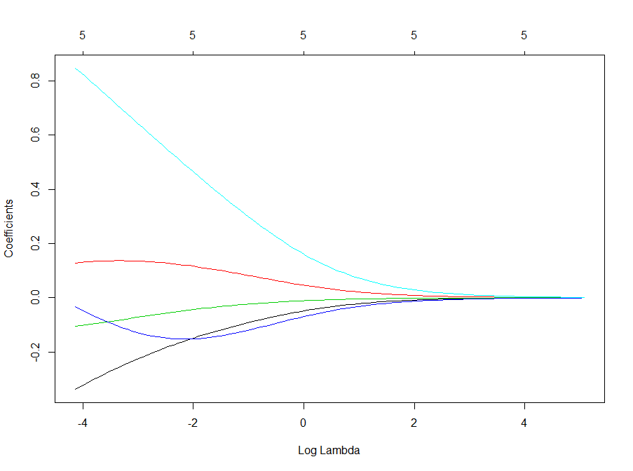
Parameter estimates (ridge) (for different values of lambda)

Slide 68
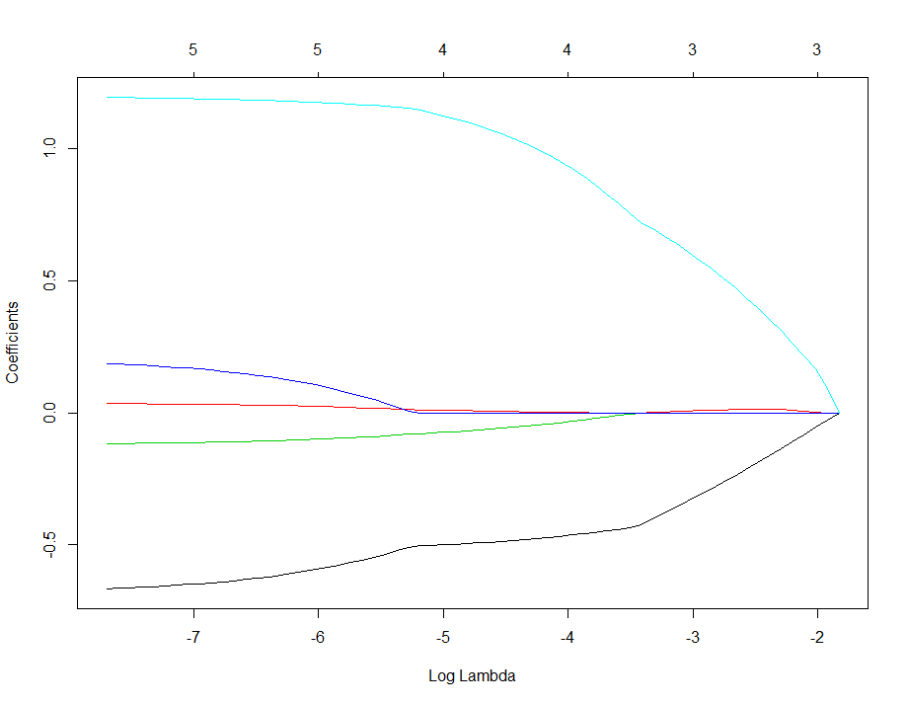
Parameter estimates (lasso) (for different values of lambda)

Slide 69
Complete logit model with lasso penalty
# Complete model with lasso penalty
# Step 1: fit the model for various values of lambda
lasso = glmnet(x, y, family = "binomial", alpha=1)
plot(lasso, xvar="lambda")
# Step 2: find the optimal value of lambda using
# cross-validation
cv.lasso = cv.glmnet(x, y, family="binomial", alpha=1)
plot(cv.lasso)
best.lambda = cv.lasso$lambda.min

Slide 70
Complete logit model with lasso penalty
# Extract prediction data from database
query = "SELECT contact_id,
DATEDIFF(20220530, MAX(act_date))/365 AS 'recency',
COUNT(amount) AS 'frequency',
AVG(amount) AS 'avgamount',
MAX(amount) AS 'maxamount'
FROM acts
WHERE (act_type_id = 'DO')
GROUP BY 1"
newdata = sqlQuery(db, query)
# Prepare new data as matrix
newdata2 = cbind(newdata$recency, newdata$frequency,
newdata$recency * newdata$frequency,
log(newdata$recency), log(newdata$frequency))
# Step 3: make predictions by specifying a specific
# value for lambda
results = predict(lasso, newdata2, s=best.lambda, type="response")
print(head(results))

Slide 71
That’s all folks !

